Slide 1
Chapter 10:
Cells divide for growth, repair, replacement and reproduction

Slide 2
10.1 The cell cycle
The cell cycle
Cells need to reproduce for organisms to grow, and new cells are also needed to replace old, dead or damaged cells.
The events that take place from one cell division to the next are called the cell cycle, and involves a number of phases:
G₁ phase, or first growth phase – the cell produces new proteins, grows and carries out its normal tasks for the body; this phase ends when the cell’s DNA begins to duplicate.
S phase, or synthesis phase – the DNA molecules in the cell nucleus form exact copies of themselves.
G₂ phase, or second growth phase – this relatively short phase involves preparation for cell division.
M phase, or mitotic phase – the cell divides into two daughter cells.
Some cells leave the cycle and stop dividing for days, years or even for the rest of the person’s life. These cells are in the G₀ phase.

Slide 3
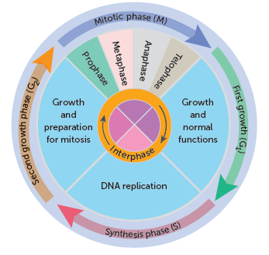
10.1 The cell cycle

Slide 4
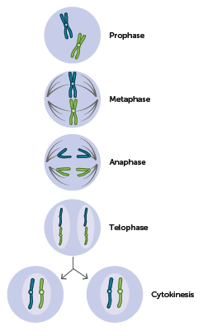
10.1 The cell cycle
Mitosis
When a cell reproduces each new cell must contain the same genetic information as the parent cell. This is achieved by division of the nucleus, known as mitosis. Mitosis ensures that each body cell receives the exact same hereditary material (DNA) as that possessed by its parent cell.
For convenience, biologists describe mitosis in four stages: prophase, metaphase, anaphase and telophase. However, the process is continuous; it does not occur in steps.
The stages of mitosis in a cell with two chromosomes

Slide 5
10.1 The cell cycle
Interphase
Interphase is the period between nuclear divisions. The cell goes through the G₁, S and G₂ phases of the cell cycle. In the S phase, the DNA molecules in the nucleus form exact copies of themselves. Therefore in the period between one cell division and the next, the quantity of DNA in the nucleus doubles.

Slide 6
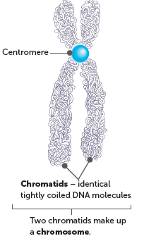
10.1 The cell cycle
Prophase
Prophase is the first phase of mitosis. Two pairs of centrioles become visible early in prophase. They move to opposite ends (or poles) of the cell and microtubules begin to radiate from them. At the same time, the nucleolus disappears and the nuclear membrane begins to break down. The chromatin threads of DNA become tightly coiled and can be seen as chromosomes. Coiling the long, delicate DNA molecules makes it easier to distribute the DNA to the daughter cells.
Each chromosome consists of two chromatids, which are joined at a point called the centromere. The two chromatids are identical, tightly coiled DNA molecules produced from DNA replication during interphase.
By the end of prophase, the centrioles have reached opposite poles of the cell and some of the microtubules radiating from them join to form a framework of fibres called a spindle. The nuclear membrane has now completely disappeared, and the chromatid pairs migrate towards the centre (equator) of the cell.

Slide 7
10.1 The cell cycle
Metaphase
During metaphase, the chromatid pairs line up on the equator of the spindle. The centromere of each pair is attached to a spindle fibre.
Anaphase
In anaphase, each pair of chromatids separates at the centromere. As the chromatids have become independent of each other, they are now each called chromosomes. The new chromosomes are then pulled away from one another towards opposite poles of the cell. The centromeres are still attached to the spindle fibres, and it seems that the spindle fibres pull the chromosomes apart in some way.
Telophase
During telophase, the two sets of chromosomes form tight groups at each pole of the cell. A nuclear membrane forms around each group, and a nucleolus appears in each new nucleus. The spindle fibres disappear, and the chromosomes gradually uncoil to become chromatin threads once more.

Slide 8
10.1 The cell cycle
Cytokinesis
While the events of telophase are occurring, the cytoplasm usually begins to divide. Division of the cytoplasm is called cytokinesis. A furrow develops in the cytoplasm between the two nuclei. The furrow gradually deepens until it cuts the cytoplasm into two parts, each with its own nucleus.
Mitosis and cytoplasmic division result in the formation of two daughter cells, which are now in interphase. Because each chromosome was duplicated prior to mitosis, and a copy went into each daughter cell, each daughter cell has exactly the same number and type of chromosomes as the parent cell. The genetic information is therefore passed from parent cell to daughter cells and without change.

Slide 9
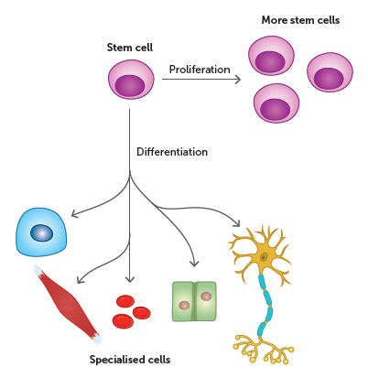
10.1 The cell cycle
Stem cells and differentiation
Differentiation
Cells are specialised so that they can carry out particular tasks. The process by which cells become specialised is called differentiation.
As the cells undergo division by mitosis, different genes become activated. This makes the cells differentiate into specialised cells that can perform particular functions – for example, stomach cells that secrete enzymes.
Stem cells can proliferate or differentiate to form specialised cells

Slide 10
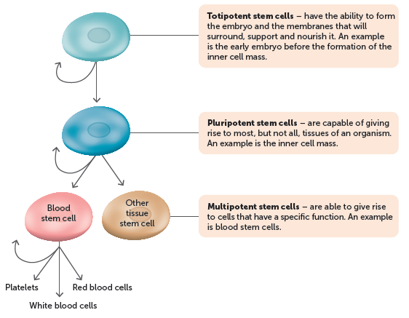
10.1 The cell cycle
Stem cells
The cells that can undergo differentiation are called stem cells. They are very different from other cells because they are not specialised for any particular role and are capable of repeated division by mitosis. In the right conditions, stem cells can differentiate into specialised cells.
Stem cells can be classified based on where they originate (embryonic, adult or cord blood) or the type of cells that they can form.
Types of stem cells and differentiation

Slide 11
10.2 Producing gametes
Producing gametes
The gametes, sperm and ova that are produced in the ovaries and testes, are the result of a special type of cell division called meiosis.
Meiosis results in daughter cells with half the number of chromosomes that were present in the original cell, known as the haploid number. The number of chromosomes in body cells is the diploid number. The chromosomes in diploid cells actually exist in pairs that are identical in shape and carry genetic information that influences the same characteristics. These are called homologous chromosomes.
When a cell has two of each type of chromosome, it has the diploid chromosome number. Diploid cells are designated 2n, where n stands for the number of different types of chromosomes. The diploid number for humans is 46. In gametes, only one of each type of chromosome is present, or n, and therefore they are described as haploid. The haploid number for humans is therefore 23.

Slide 12
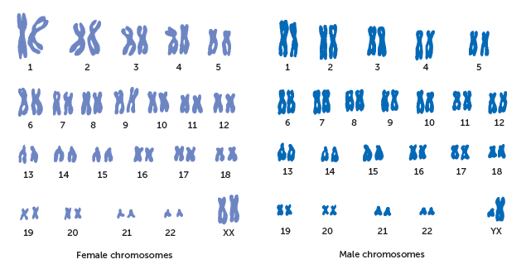
10.2 Producing gametes
Human cells, except for gametes, are diploid and contain two chromosomes from each homologous pair

Slide 13
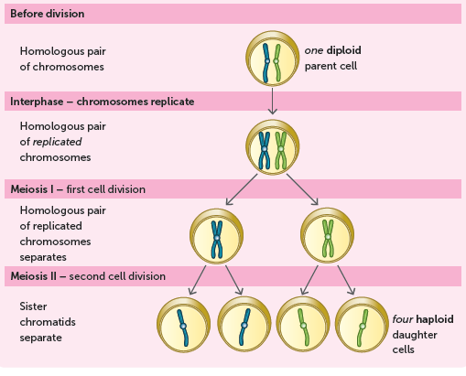
10.2 Producing gametes
The process of meiosis involves two nuclear divisions, but the chromosomes only duplicate once.
Interphase: Prior to undergoing meiosis, a cell goes through an interphase stage where it grows and the DNA is replicated. This DNA replication occurs in the same way as it does in mitosis.
First division: The homologous pairs separate and two daughter cells form with 23 chromosomes, each with two chromatids.
Second division: The chromatids separate, resulting in four daughter cells with 23 chromosomes, each with one chromatid.

Slide 14
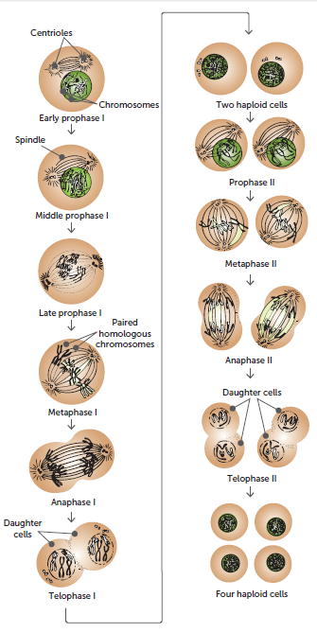
10.2 Producing gametes
First and second meiotic division
The two stages of meiosis result in four haploid daughter cells.

Slide 15
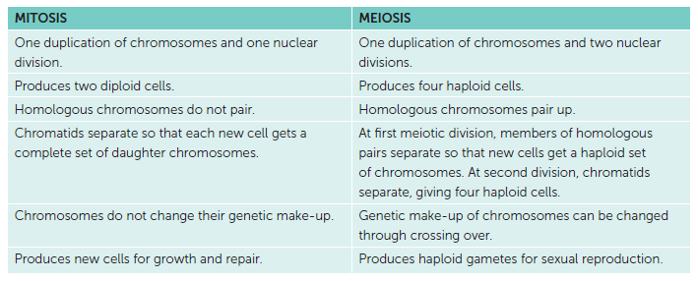
10.2 Producing gametes
Differences between mitosis and meiosis
Both processes involve the replication of DNA to produce a doubling of the number of chromosomes prior to cell division taking place. However, mitosis produces diploid cells for growth and repair within the tissues, whereas meiosis produces haploid gametes for sexual reproduction.

Slide 16
10.3 Variation in daughter cells
Variation in daughter cells is a result of crossing over, non-disjunction and random (or independent) assortment.
Crossing over
An important feature of meiosis occurs during the prophase of the first meiotic division. When the homologous chromosomes are paired, the chromatids may cross, break and exchange segments. This is called crossing over and the point where two chromatids cross is called a chiasma. Crossing over can result in a new combination of alleles along the chromosome, called recombination. Therefore, crossing over creates new combinations of genes so that the chromosomes passed on to the offspring are not exactly the same as those inherited from the parents.

Slide 17
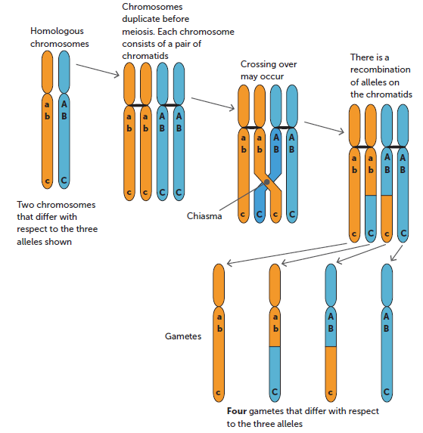
10.3 Variation in daughter cells

Slide 18
10.3 Variation in daughter cells
Non-disjunction
During the first division of meiosis, the homologous chromosomes pair and then separate. Sometimes one or more of the chromosome pairs may fail to separate when the cell divides. In the second meiotic division, one or more of the chromatids may fail to separate. These situations are called non-disjunction, and they result in one of the daughter cells receiving an extra chromosome and the other daughter cell lacking that chromosome.
Trisomy is a condition in which an individual inherits an extra copy of a chromosome – three copies instead of the normal two. One such chromosomal defect is Down syndrome, or trisomy 21.
Monosomy is where an individual is missing a chromosome – they have only one copy instead of the normal two.
Partial monosomy and partial trisomy can also occur. In partial monosomy, part of a chromosome is missing – part of the chromosome has two copies, but part has only one copy. Partial trisomy occurs when part of an extra chromosome is attached to one of the other chromosomes.

Slide 19
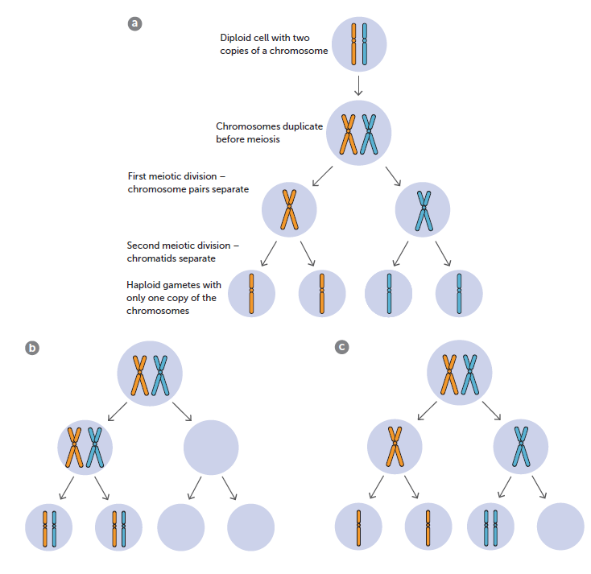
10.3 Variation in daughter cells
a Normal meiosis;
b Non-disjunction in the first meiotic division;
c Non-disjunction in the second meiotic division

Slide 20
10.3 Variation in daughter cells
Random (or independent) assortment
During the first meiotic division, the homologous pairs of chromosomes separate at random. When the chromosomes move apart during the first meiotic division, they do so independently, i.e. the way one pair of chromosomes separates is unaffected by the way any of the other pairs separate. This random, independent assortment takes place for each of the 23 pairs of human chromosomes.
That means any single human egg receives one of two possible chromosomes 23 times. The total number of possible chromosome combinations is 2²³, which is approximately 8.4 million. The same random assortment goes on as each sperm cell is produced, too. Therefore when a sperm fertilises an egg, the resulting zygote contains a combination of genes arranged in an order that has probably never occurred before and will probably never occur again.

Slide 21
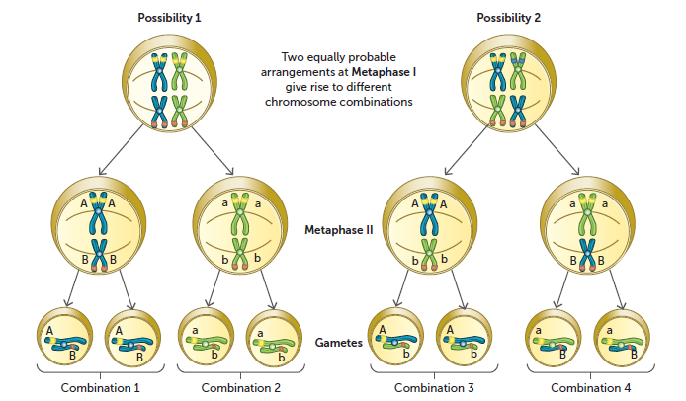
10.3 Variation in daughter cells
There are four possible combinations of chromosomes in gametes produced by a cell with just four chromosomes (two pairs)

Slide 22
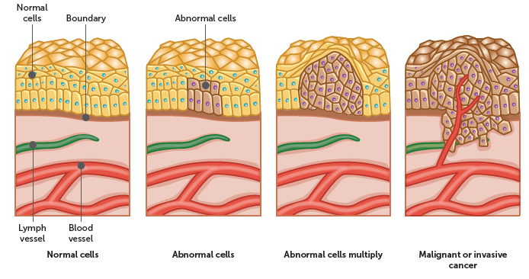
10.4 Cancer
Cancer
Cancer results from the uncontrolled division of cells. This uncontrolled growth of abnormal cells produces a mass, or tumour.
Cancer cells do not differentiate into the normal tissue cells that surround the tumour. Some tumours are malignant, which means the tumour cells are able to spread to other parts of the body, known as metastasis.
In this way, secondary tumours may develop in parts of the body well away from the original tumour.

Slide 23
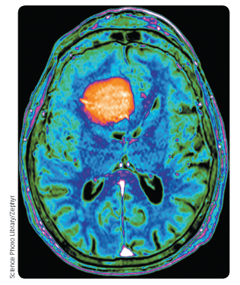
10.4 Cancer
Some tumours are not malignant as they are not able to invade normal tissues, blood or lymph vessels, and so do not spread to other parts of the body. These tumours are called benign. Benign tumours grow and press on surrounding tissues, and can be dangerous if they exert pressure on vital organs such as the brain.
However, because a capsule often surrounds them, they are usually easily removed.

Slide 24
10.4 Cancer
Causes of cancer
Carcinogens
Certain environmental factors called carcinogens can trigger malignant tumours. Cancer usually occurs only after long exposure to a carcinogen, and the cancer may develop many years after the exposure has ended.
UV radiation produces cancer in the skin
X-rays are known to cause cancer (in Australia, exposure is limited and controlled)
Ionising radiation, such as that produced by radium and ores of uranium, can cause cancer
Viruses can cause some cancers, e.g. the human papilloma virus causes cancer of the cervix in women
Chemical carcinogens, including alcohol, asbestos and tobacco tar, can cause cancer with excessive exposure.

Slide 25
10.4 Cancer
Prevention of cancer
Many cancers are associated with lifestyle factors, such as exposure to UV radiation, smoking, alcohol consumption and diet.
In Australia, the incidence of cancer has been reduced by:
Education: The public has been made aware, through advertising and other education programs, of the need to limit exposure to carcinogens. For example the Slip! Slop! Slap! Seek! Slide program.
Legislation: Australian governments have passed laws to control exposure to carcinogens. For example, smoking is banned in most public places, advertising of tobacco is not permitted, and cigarettes must be sold in plain packaging with graphic health warnings.
Everyone has a responsibility to minimise their own cancer risks by making positive lifestyle choices.

Slide 26
10.4 Cancer
Early detection of cancer
Early detection is critical for the successful treatment cancer. Tests are now available for a number of common cancers so that treatment may begin at a very early stage of tumour growth.
Cervical Screening Test (cervical cancer)
Mammography (breast cancer)
Faecal occult blood test (bowel cancer)
Digital rectal examination, prostate-specific antigen blood test, and biopsy (prostate cancer)

